Slide 1

HOTEL BOOKING
Project
2024

Slide 2
Wafaa Sayed Mohamed
Mostafa Mahmoud Nagaty
Amaal Mostafa Alassal

Slide 3
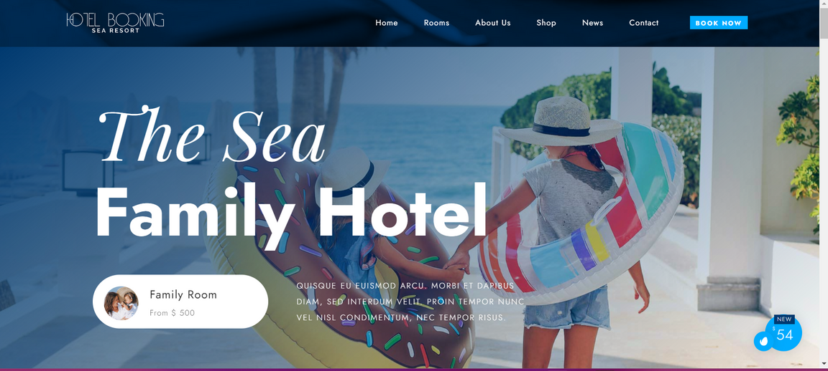
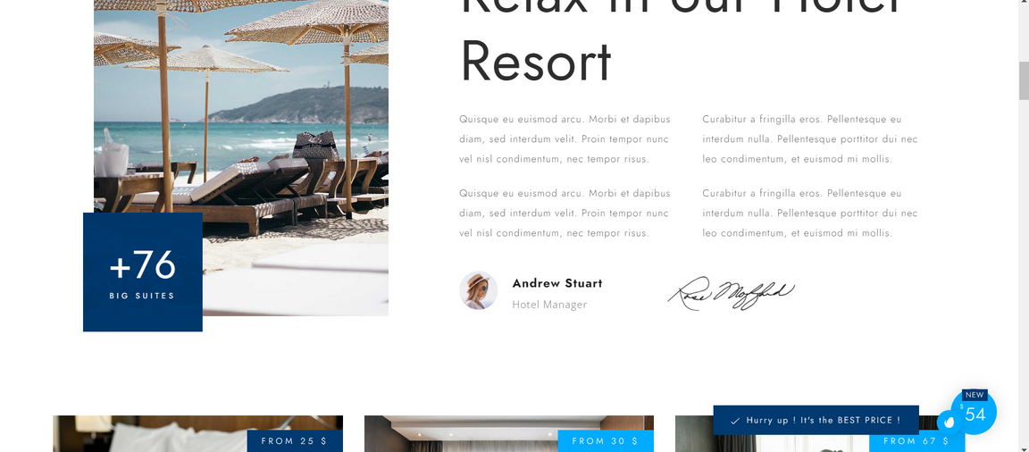
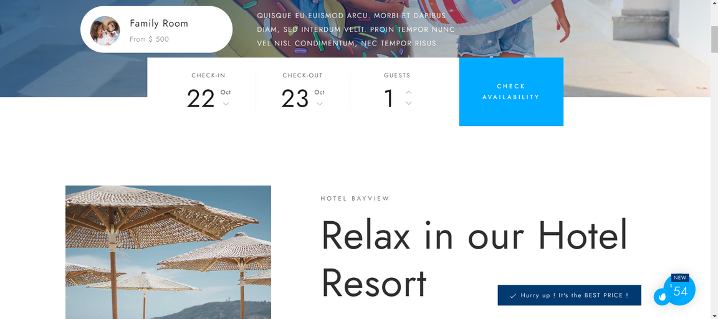
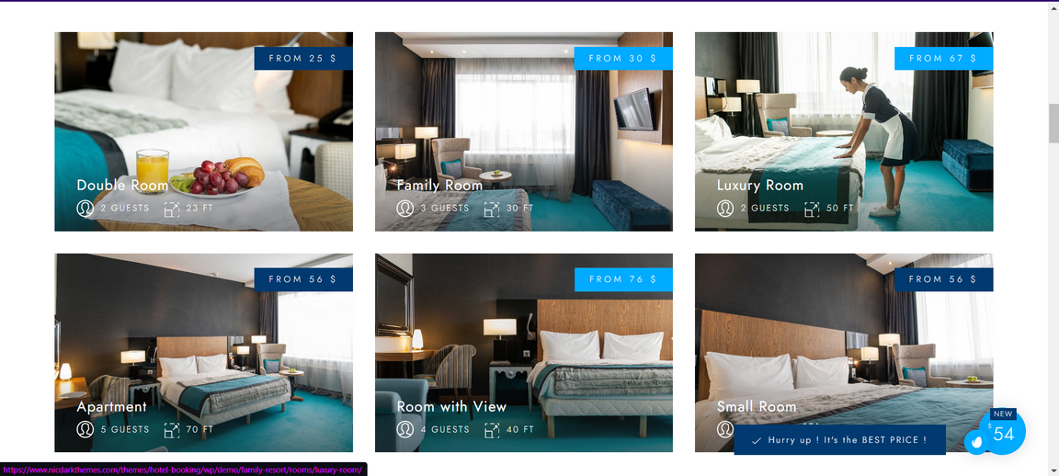
1
Demo
2
Home
3
4
5
6
7
8
9
10
11
12
13
14

Slide 4
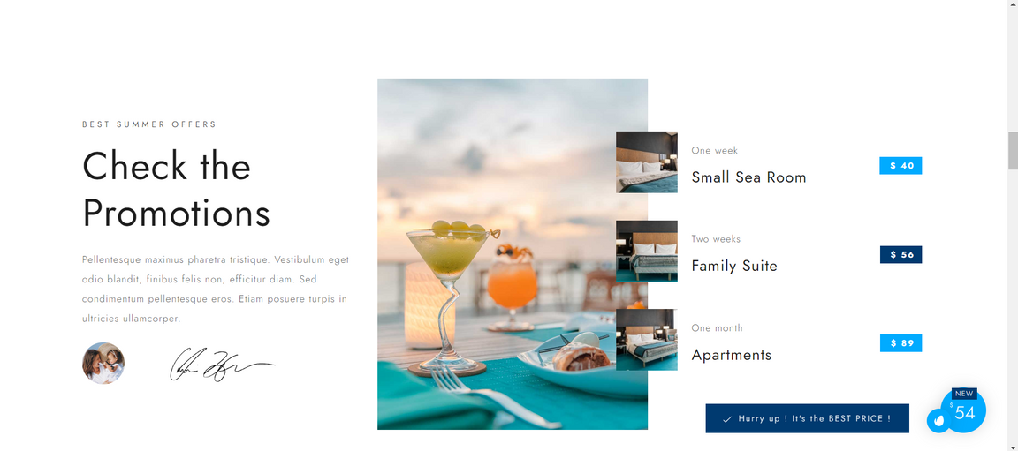
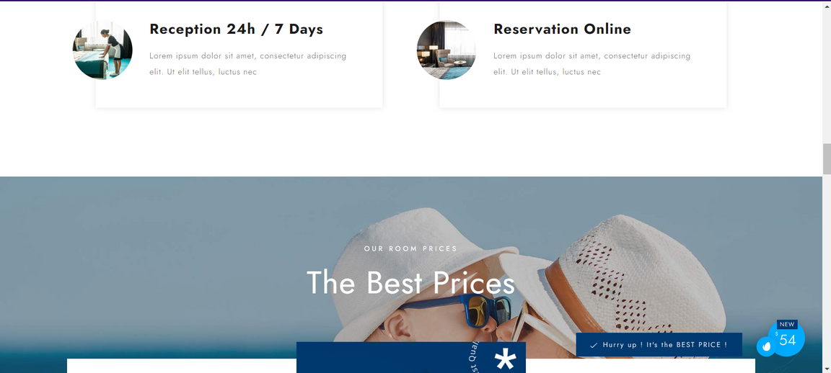
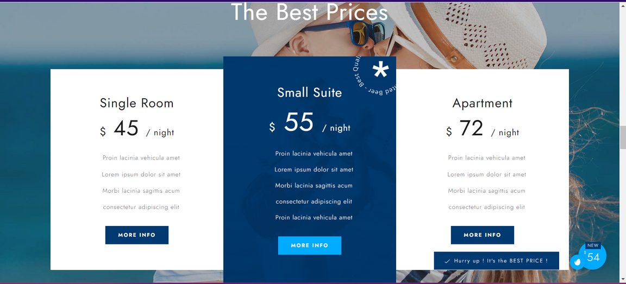
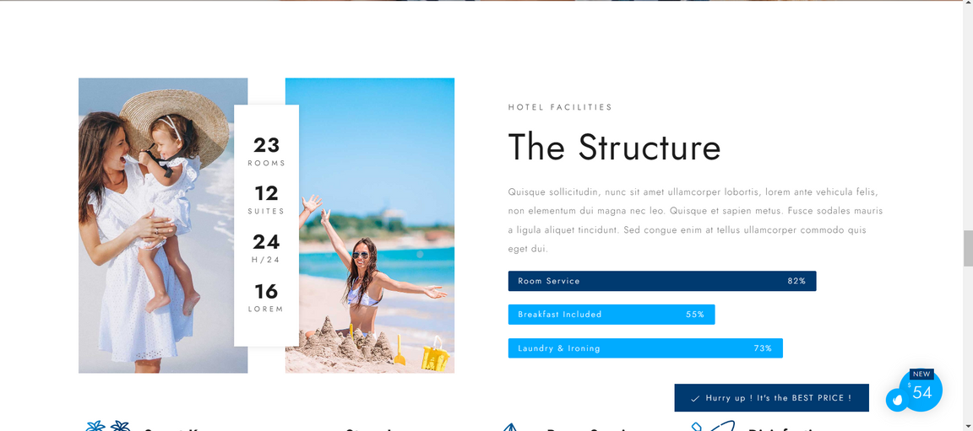
1
Home
2
3
4
5
6
7
8
9
10
11
12
13
14

Slide 5

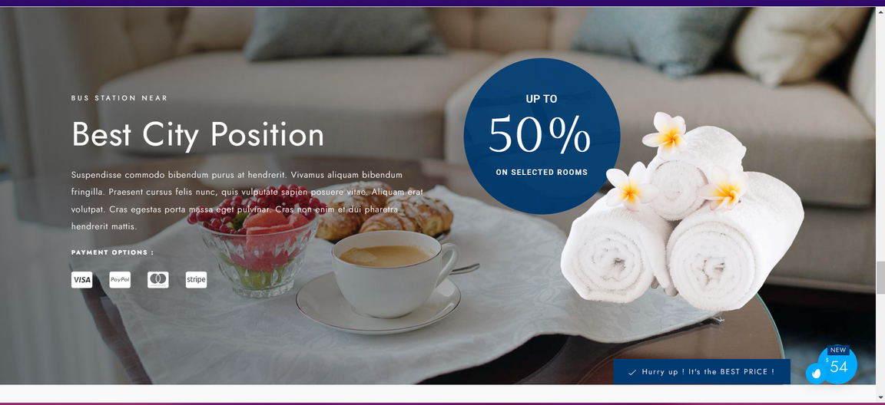
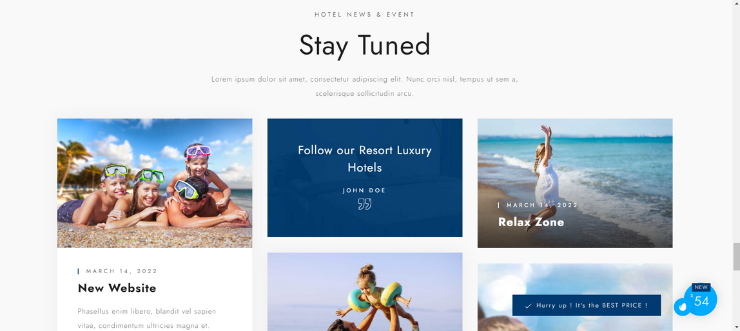
1
Home
2
3
4
5
6
7
8
9
10
11
12
13
14

Slide 6
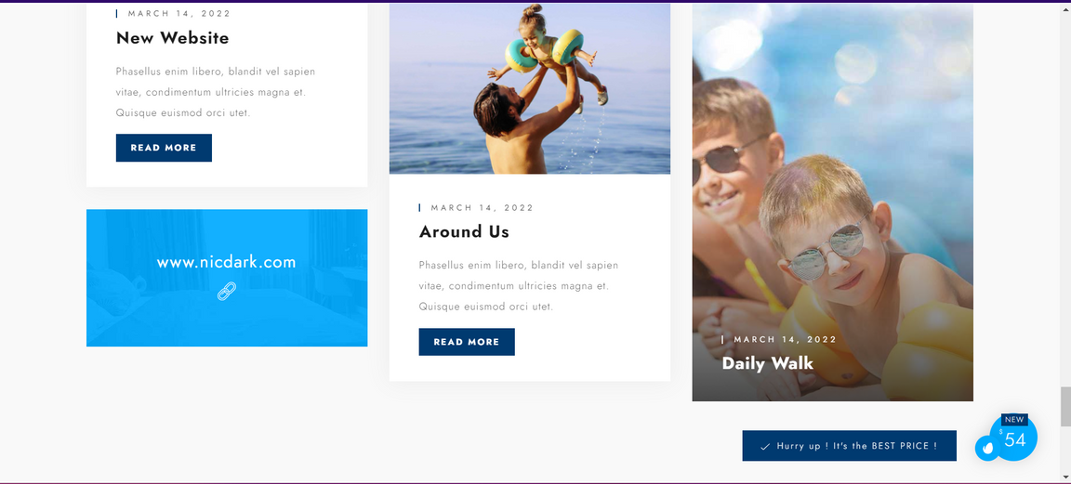
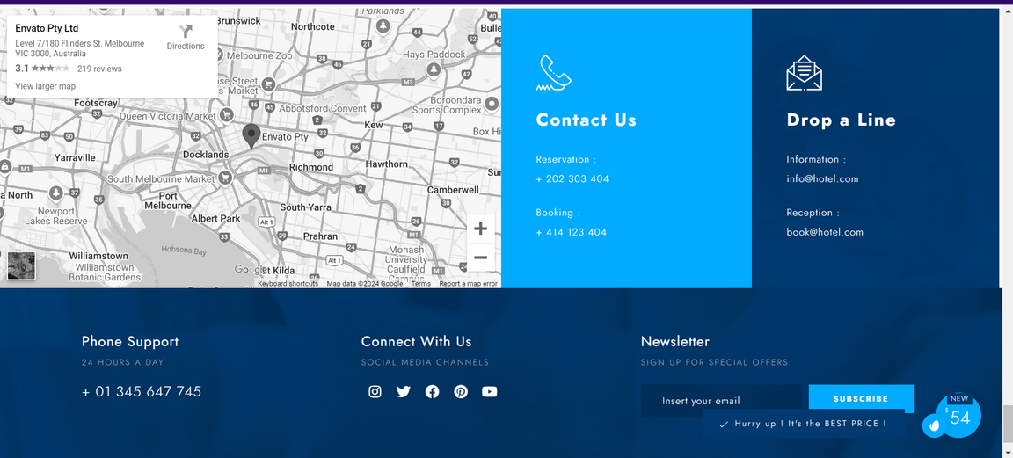
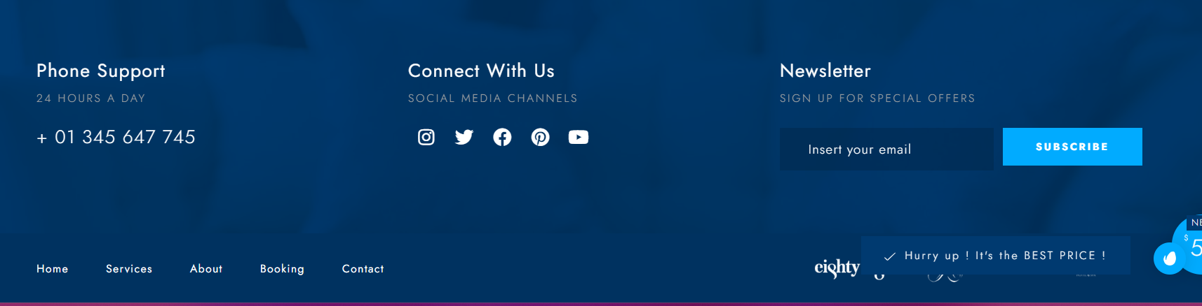
1
Home
2
3
4
5
6
7
8
9
10
11
12
13
14

Slide 7
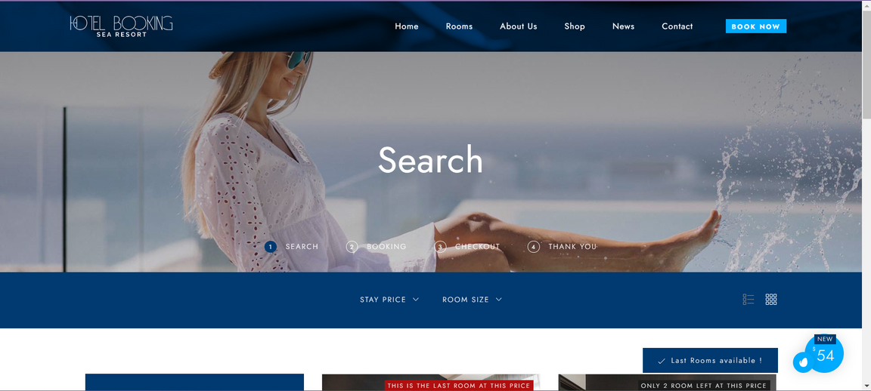
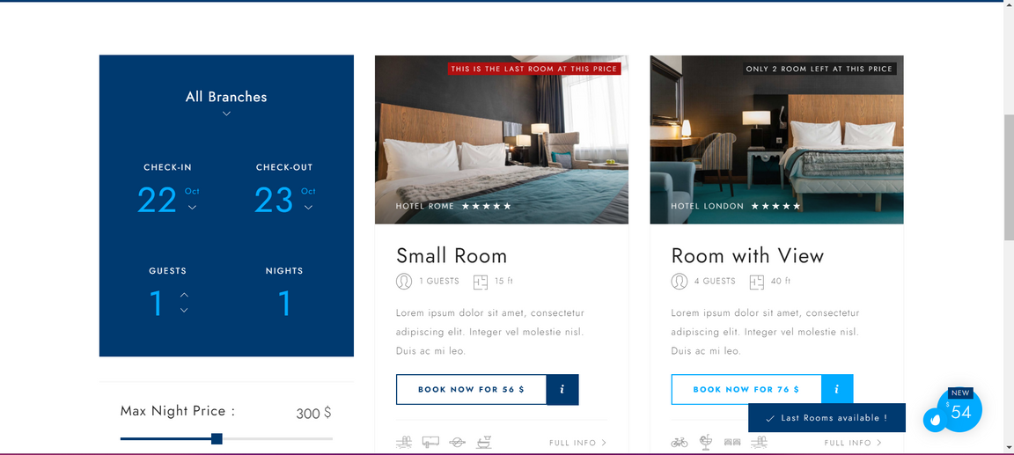
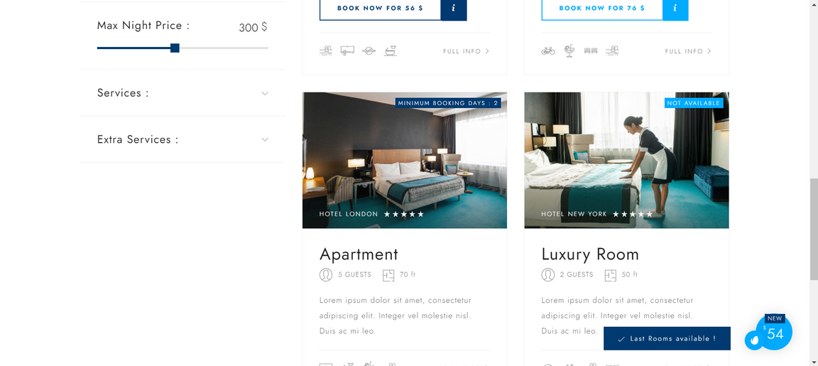
1
Rooms
2
3
4
5
6
7
8
9
10
11
12
13
14

Slide 8
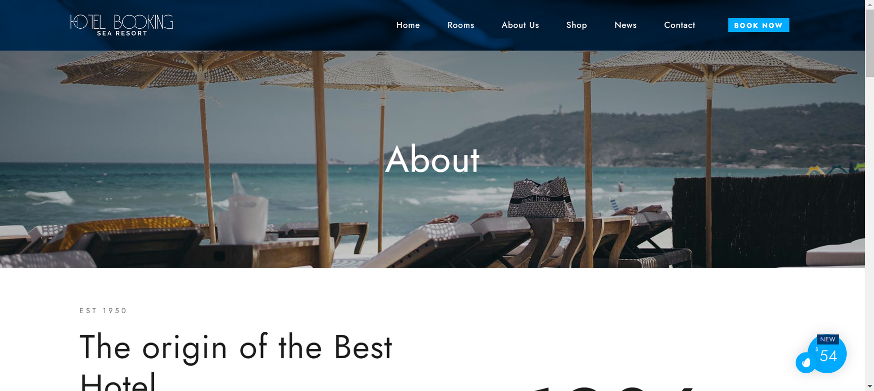
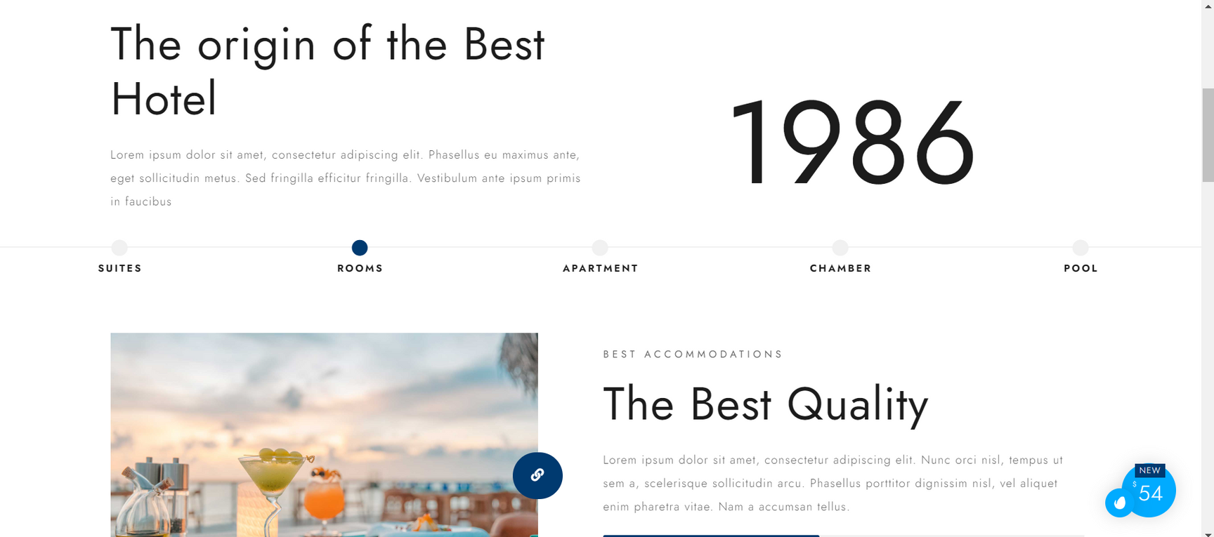
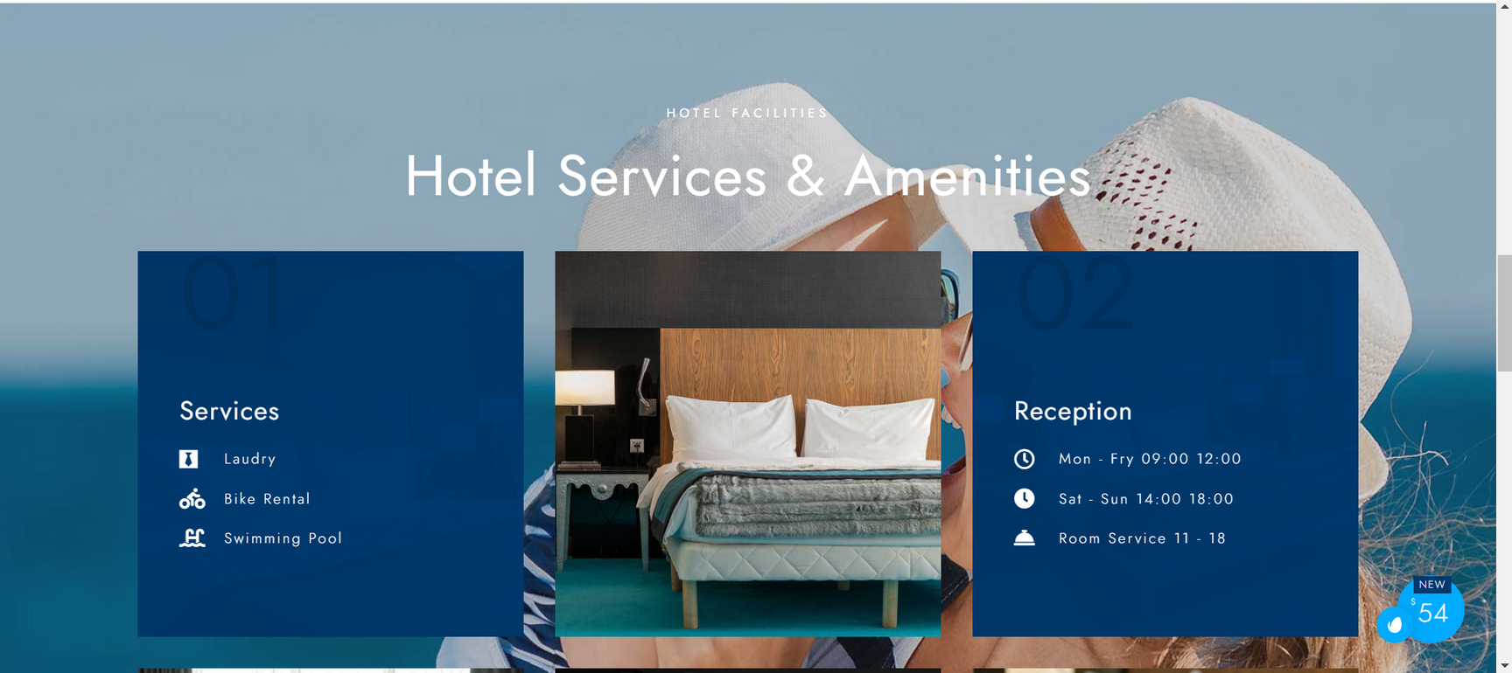
1
About Us
2
3
4
5
6
7
8
9
10
11
12
13
14

Slide 9
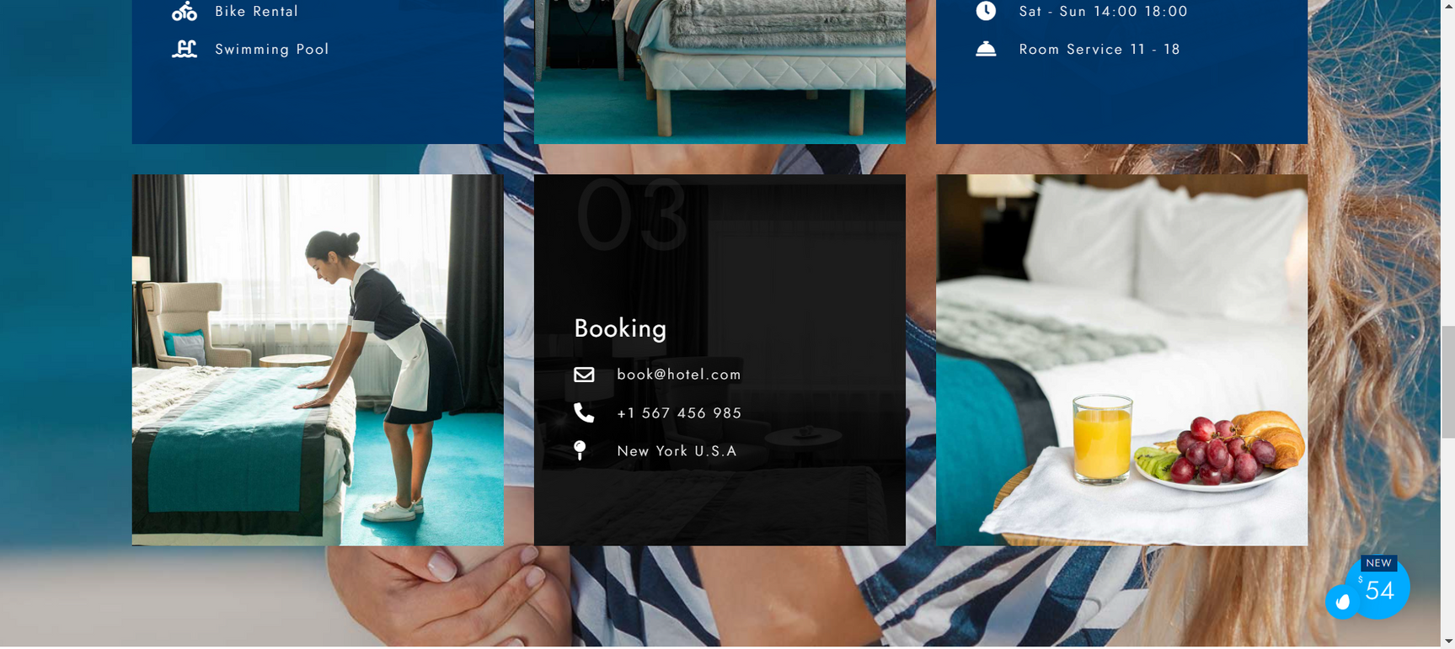
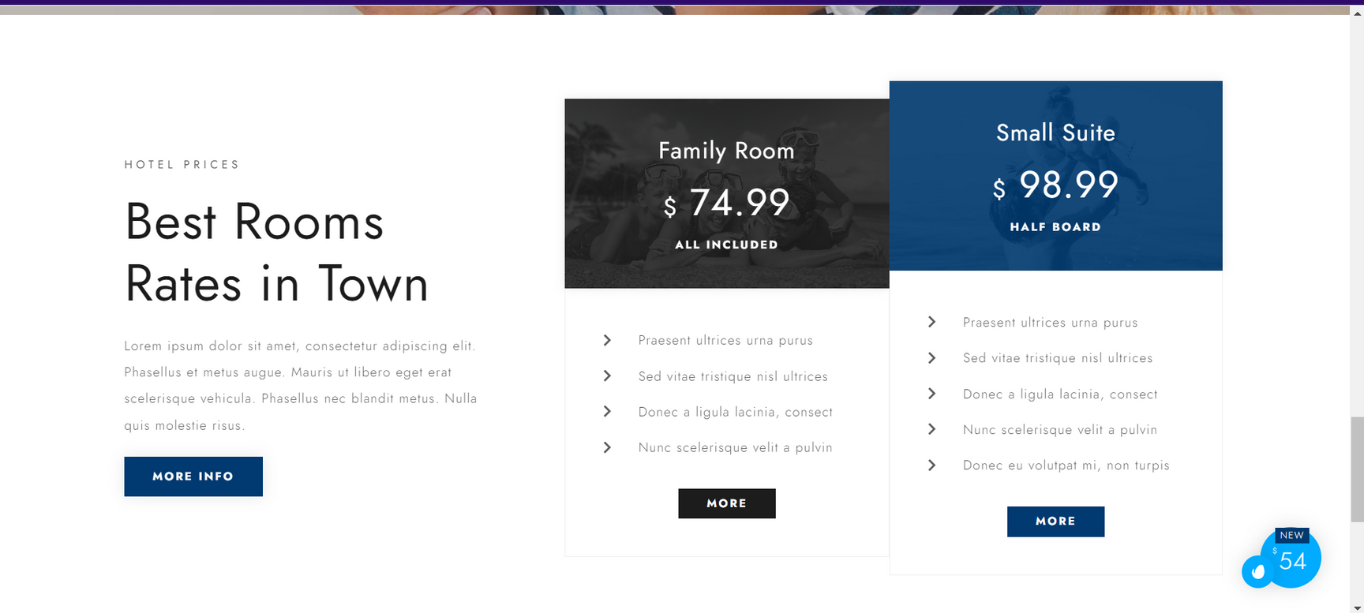
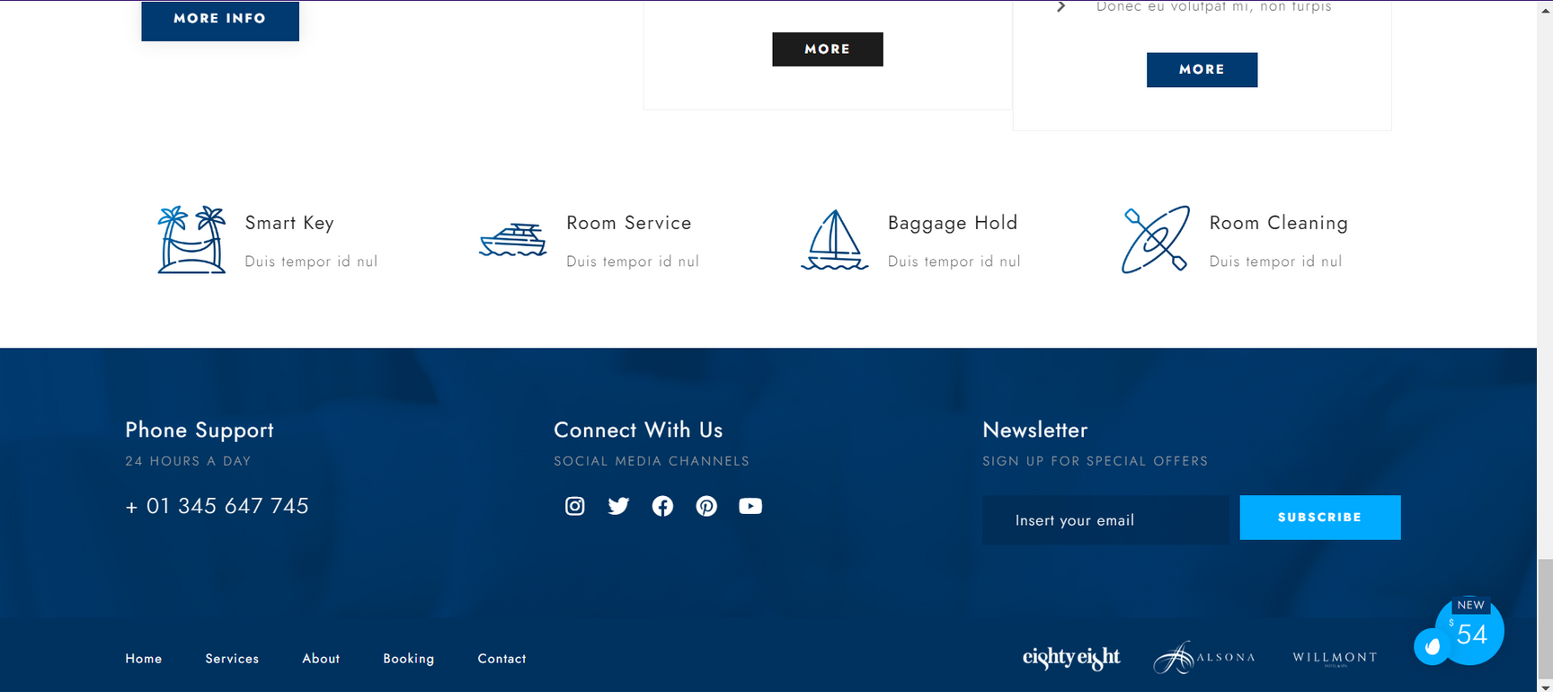
1
About Us
2
3
4
5
6
7
8
9
10
11
12
13
14

Slide 10
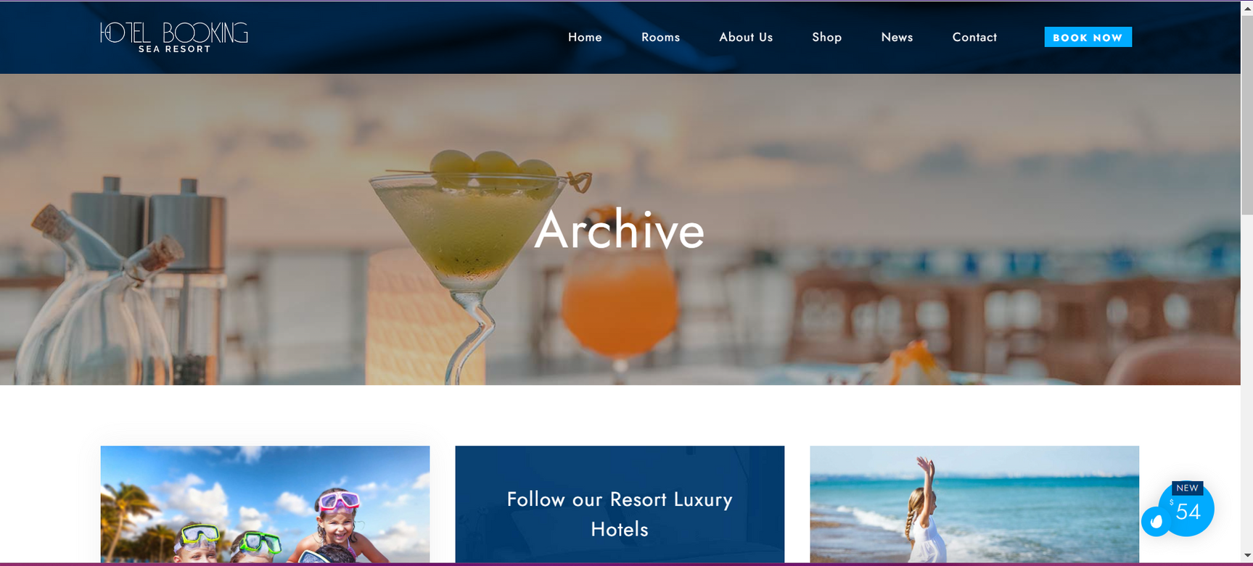
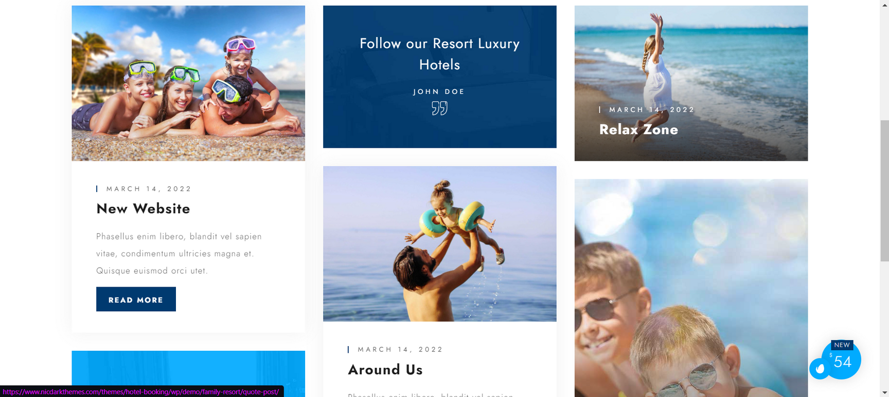
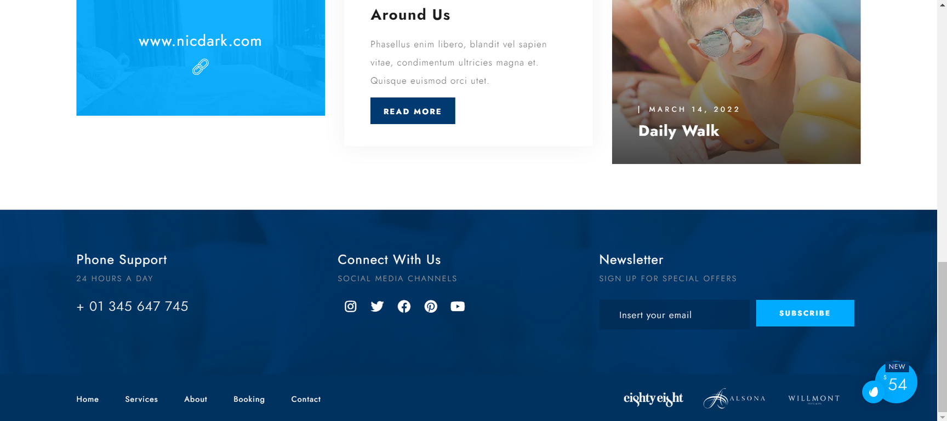
1
News
2
3
4
5
6
7
8
9
10
11
12
13
14

Slide 11
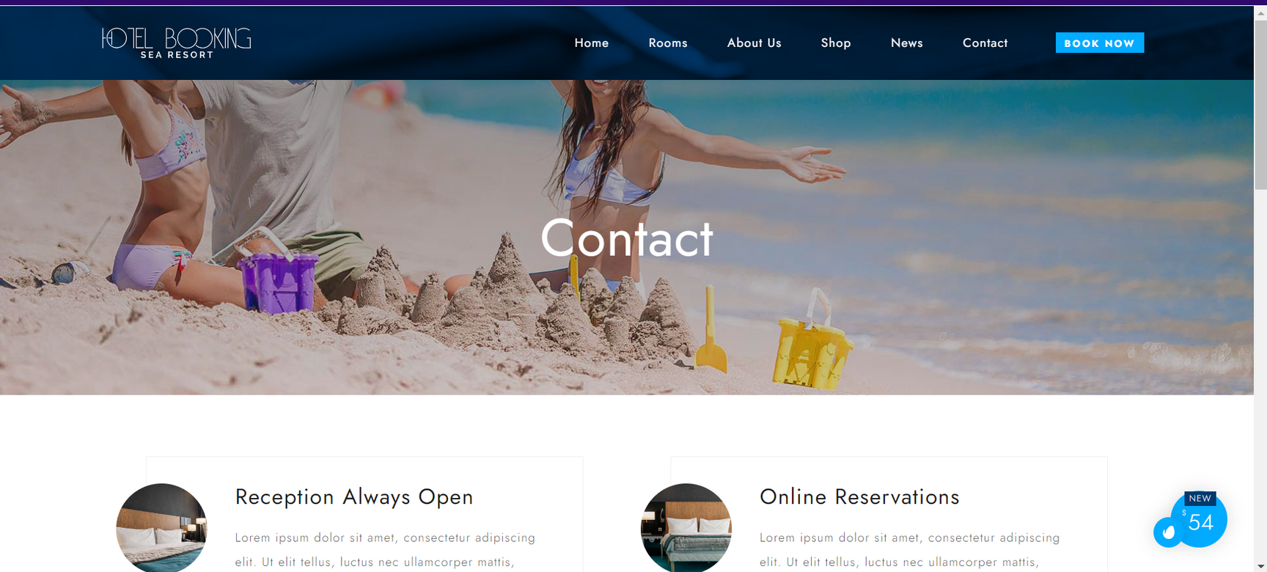
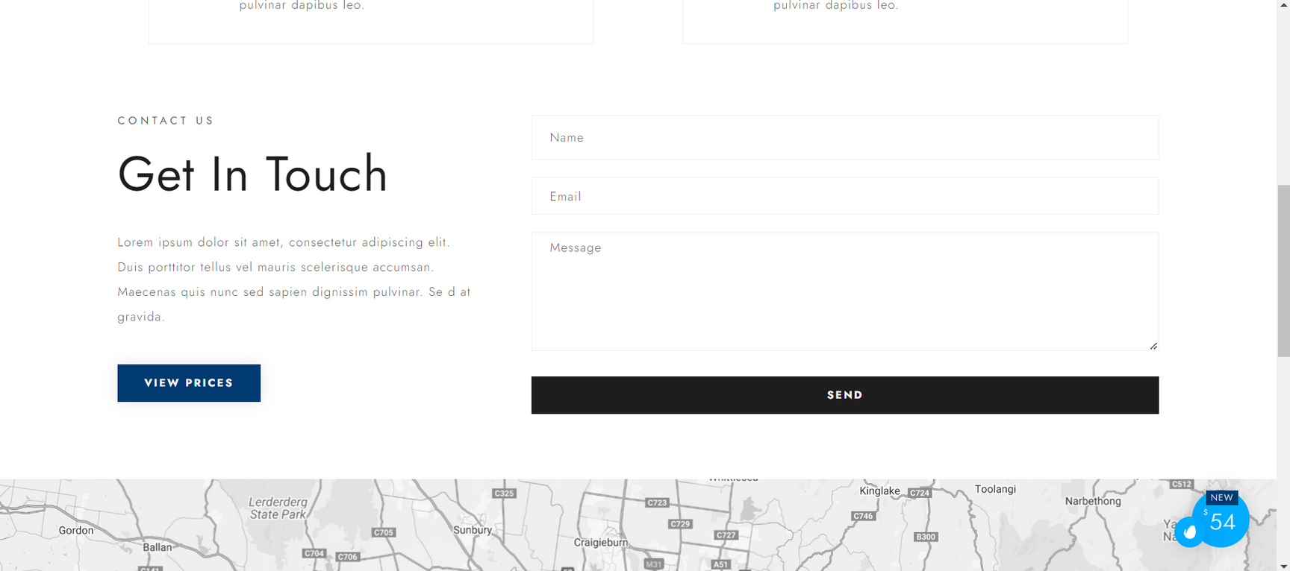
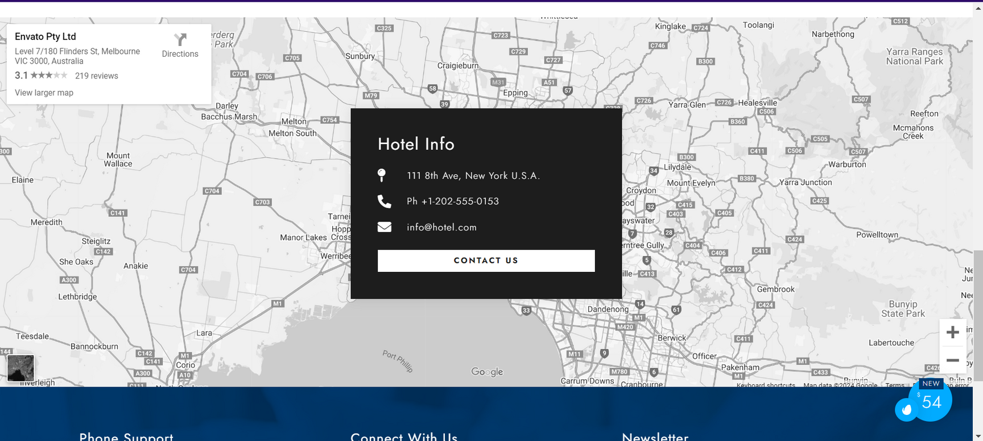
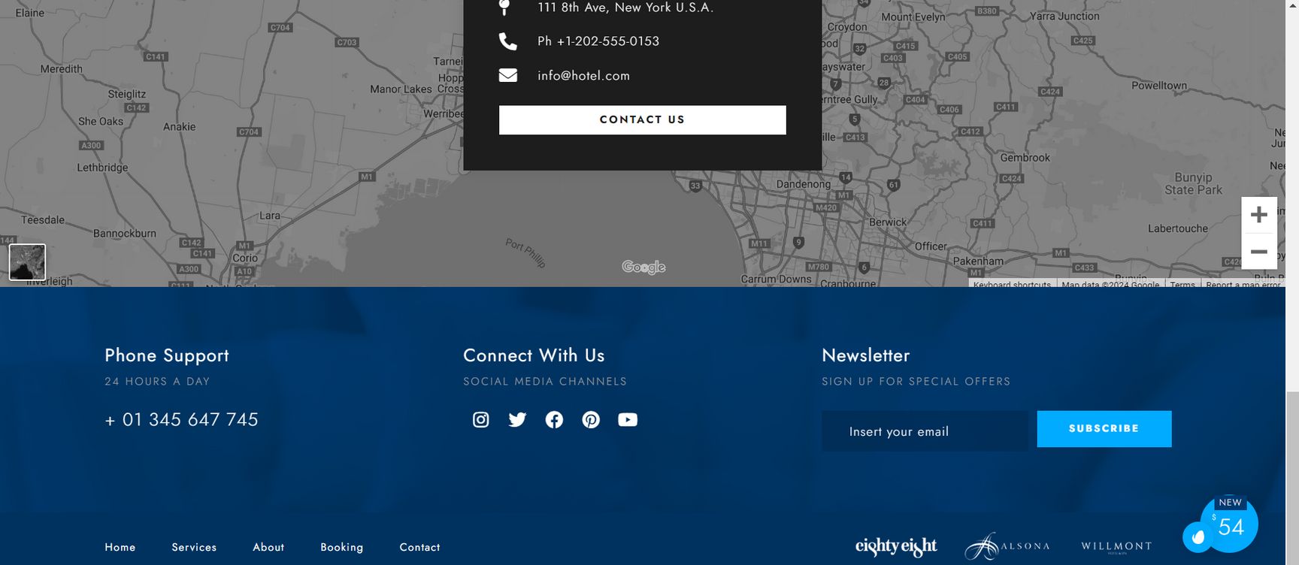
1
Contact
2
3
4
5
6
7
8
9
10
11
12
13
14

Slide 12
1
2
3
4
5
6
7
Our Project
8
9
10
11
12
13
14

Slide 13
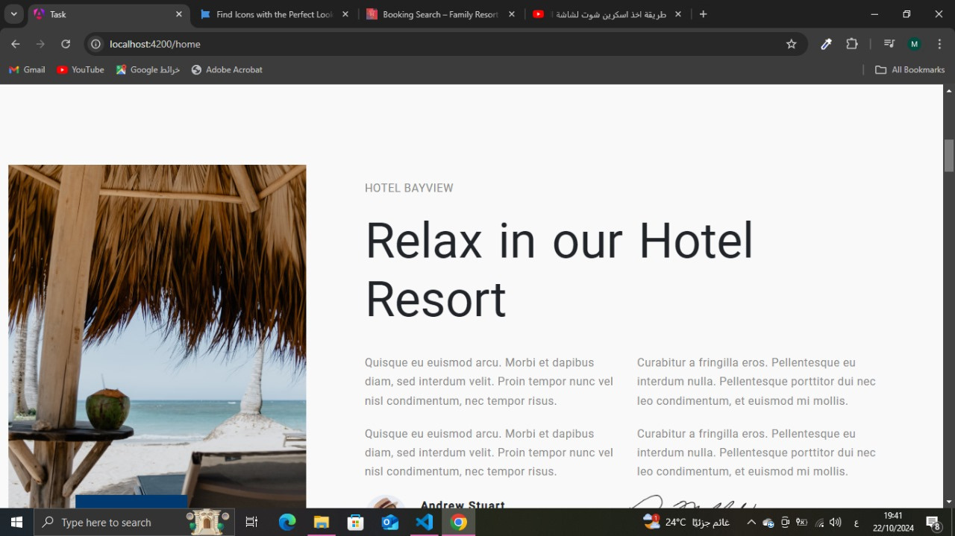
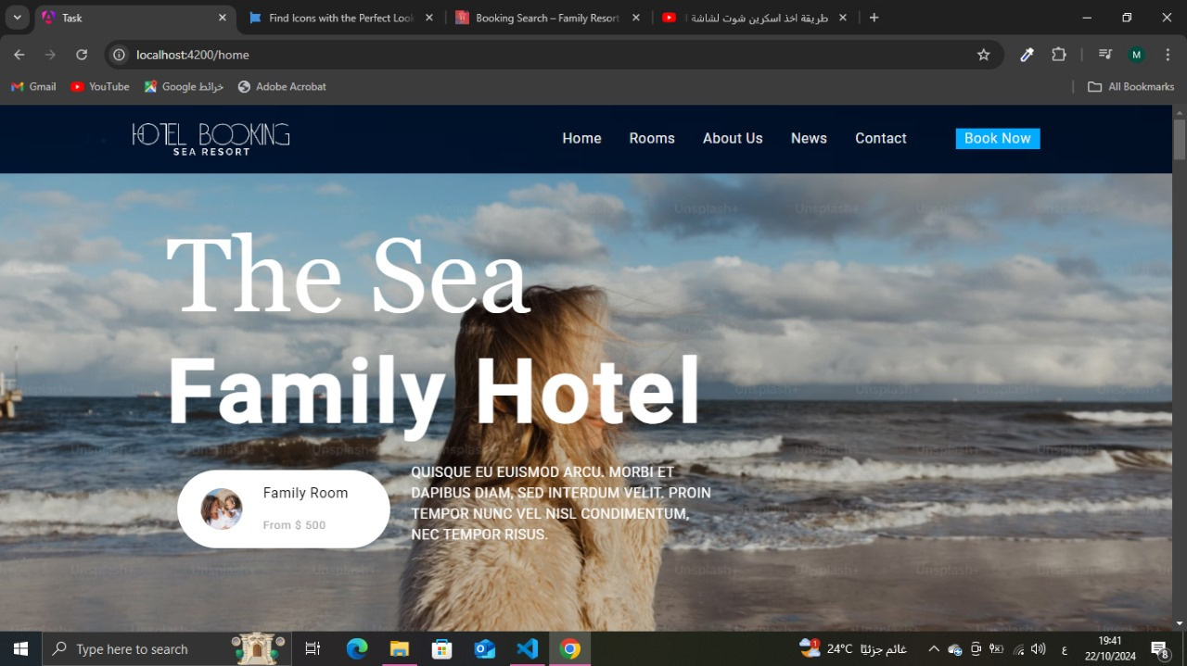
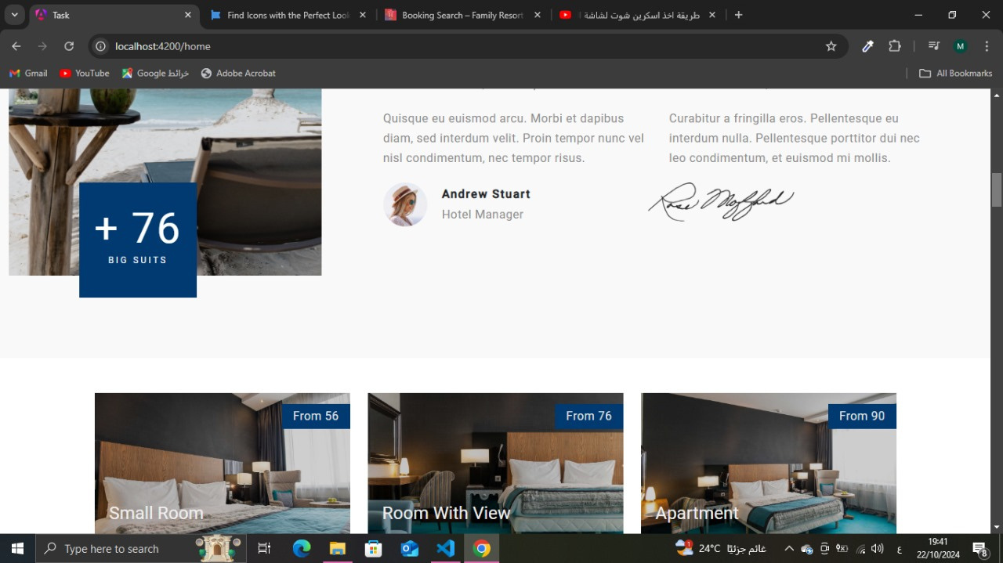
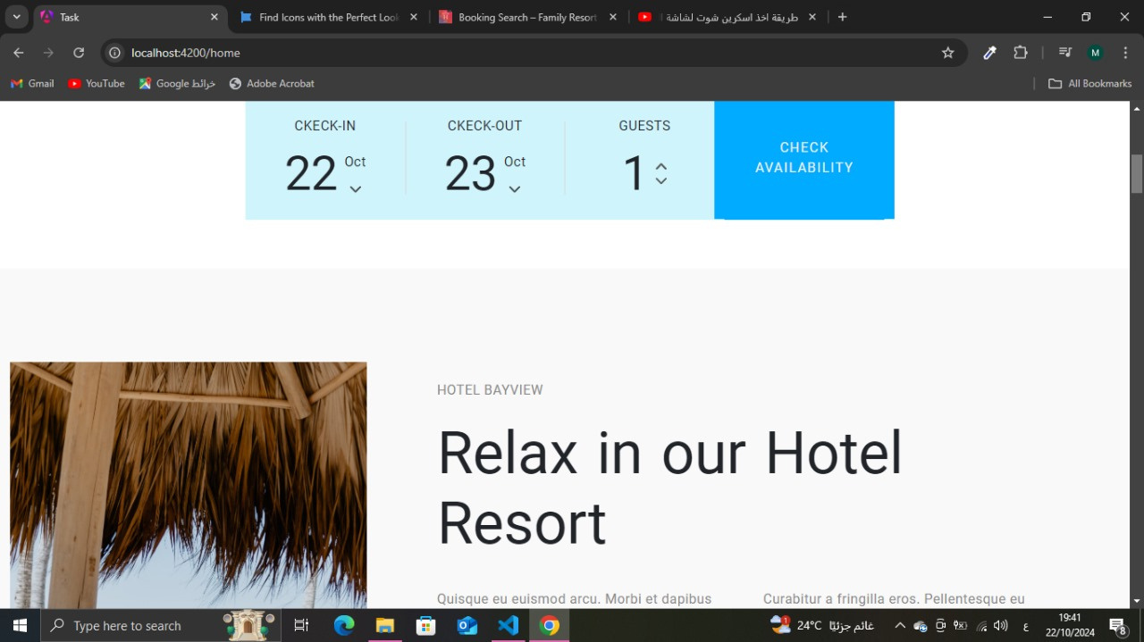
1
Home
2
3
4
5
6
7
8
9
10
11
12
13
14

Slide 14
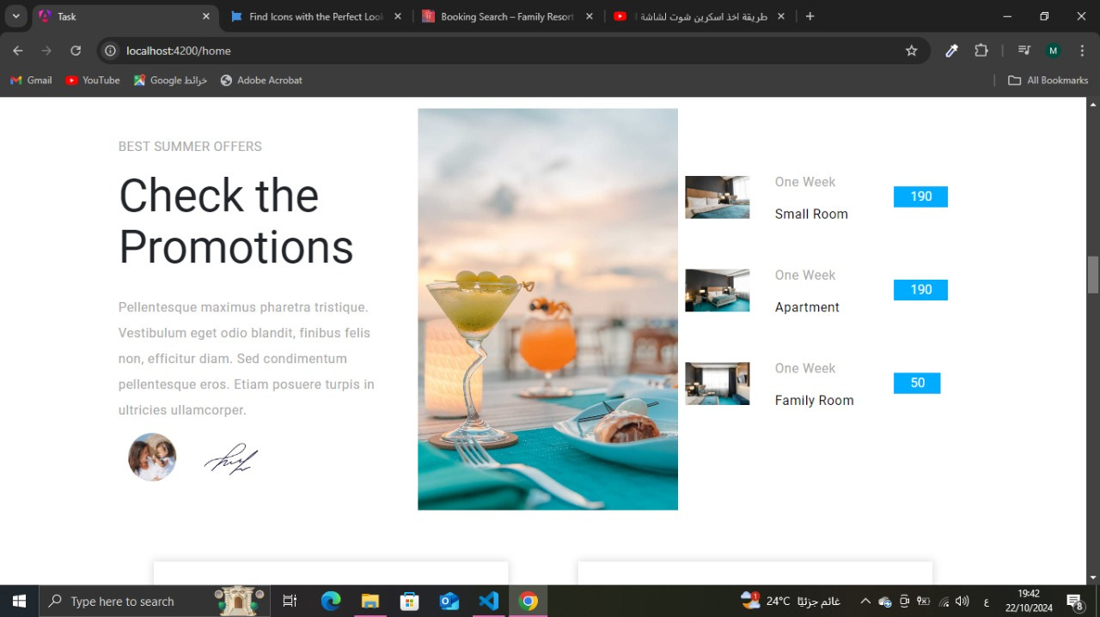
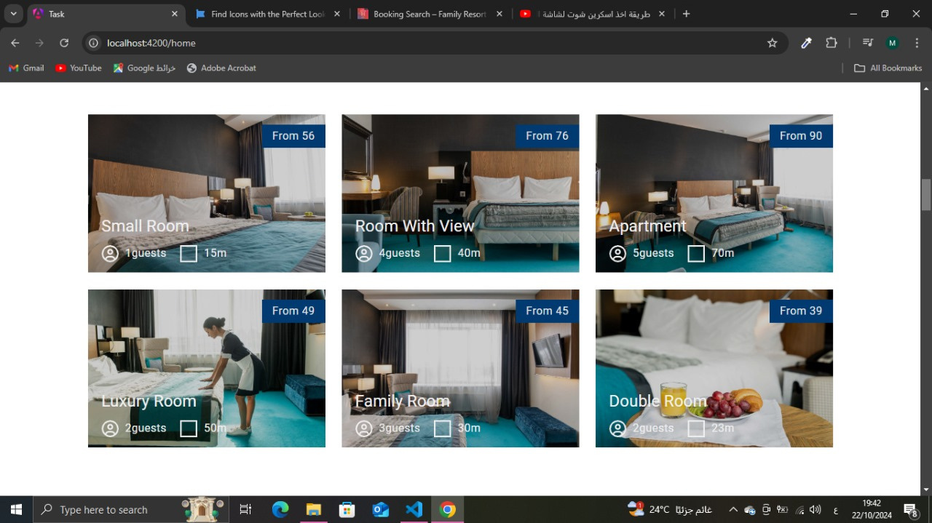
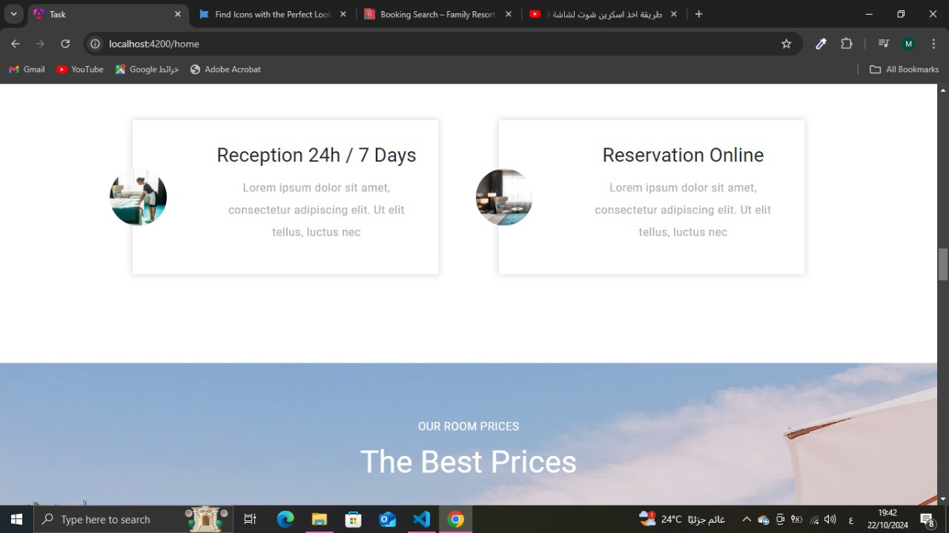
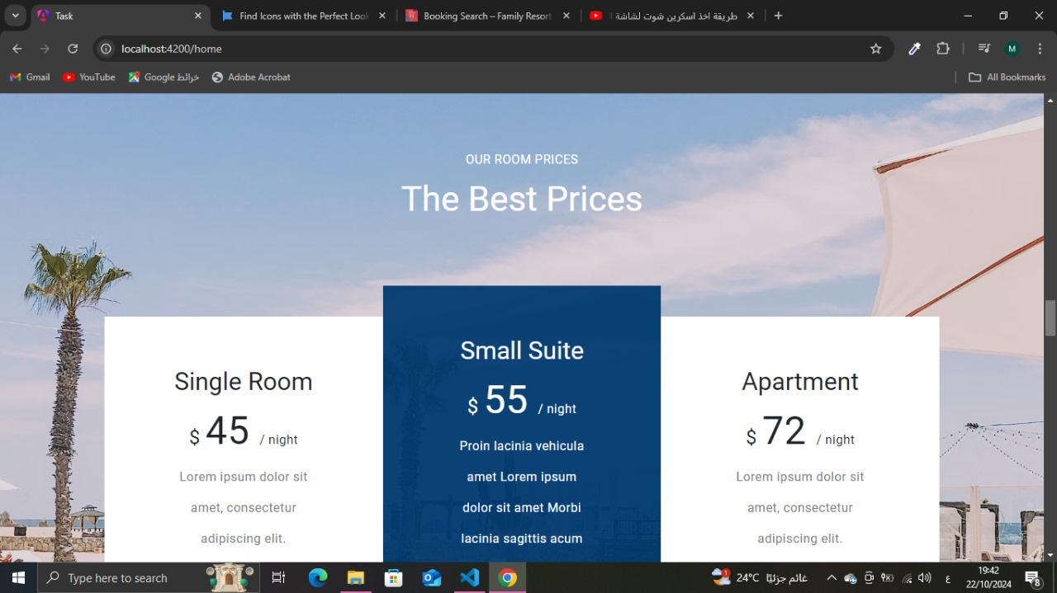
1
Home
2
3
4
5
6
7
8
9
10
11
12
13
14

Slide 15
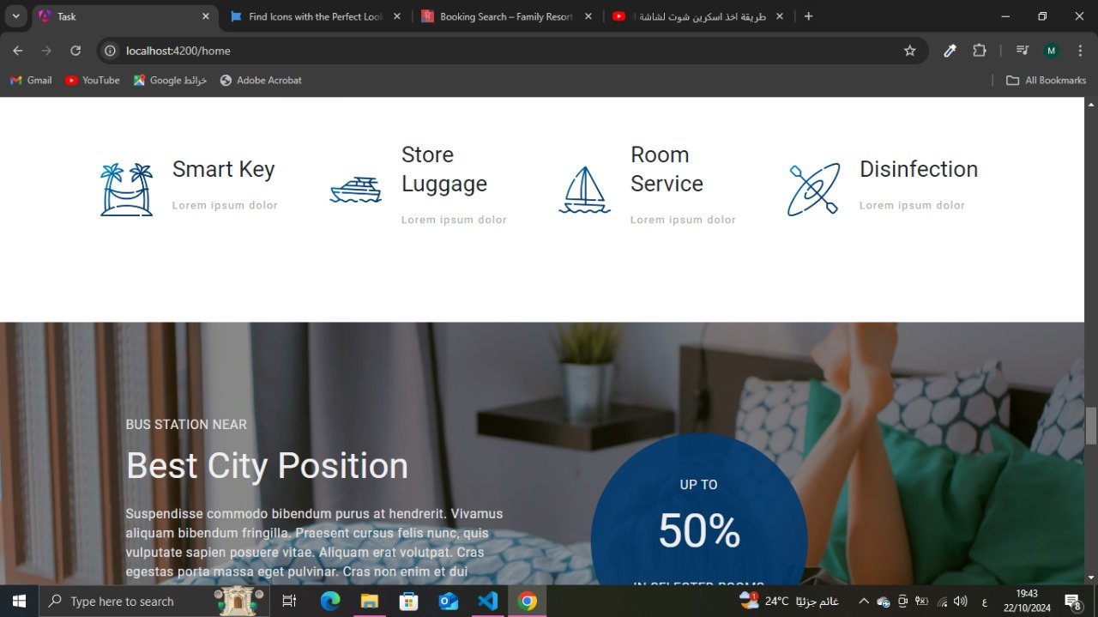
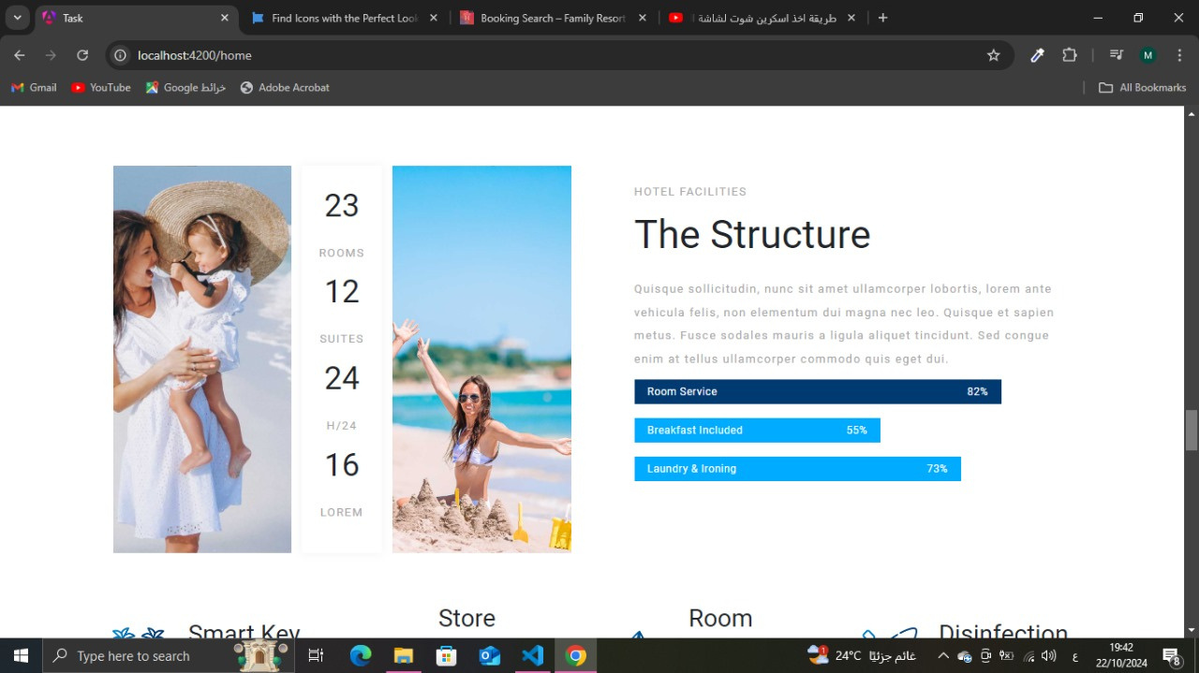
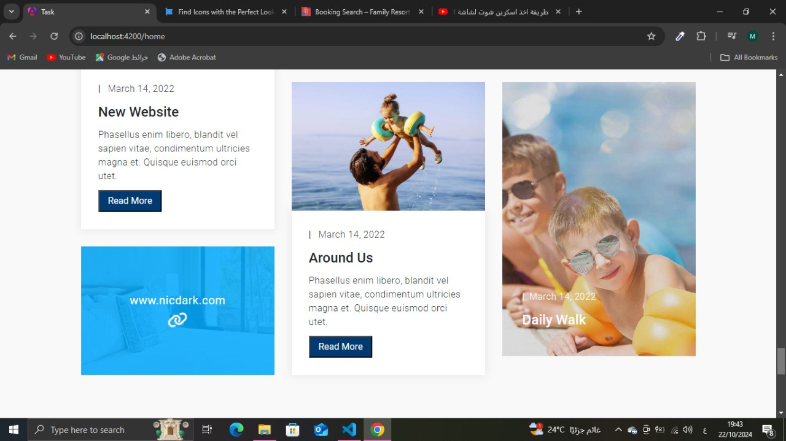
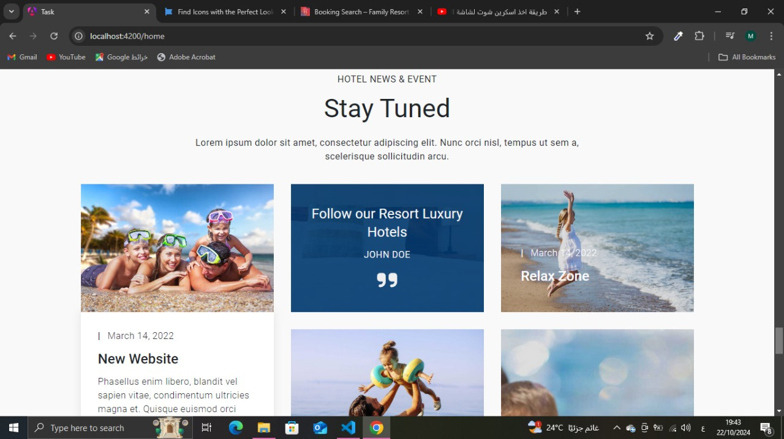
1
Home
2
3
4
5
6
7
8
9
10
11
12
13
14

Slide 16
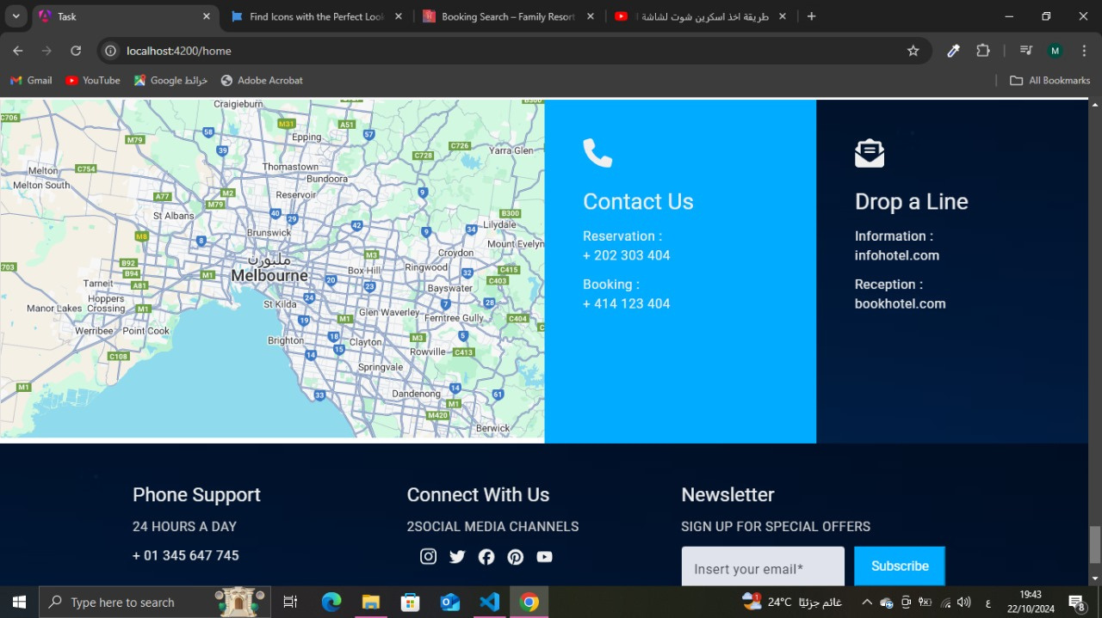
1
Home
2
3
4
5
6
7
8
9
10
11
12
13
14

Slide 17
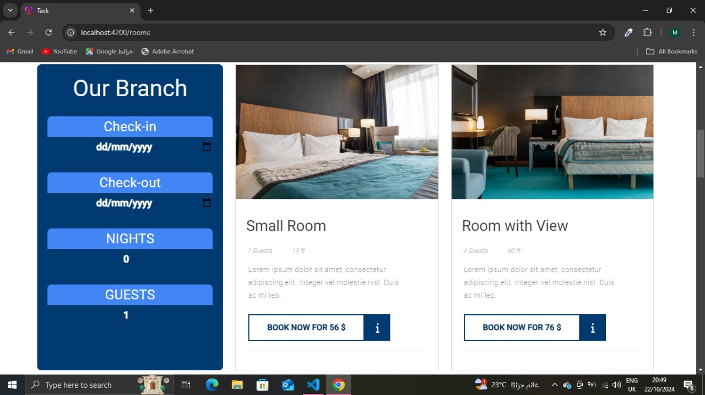
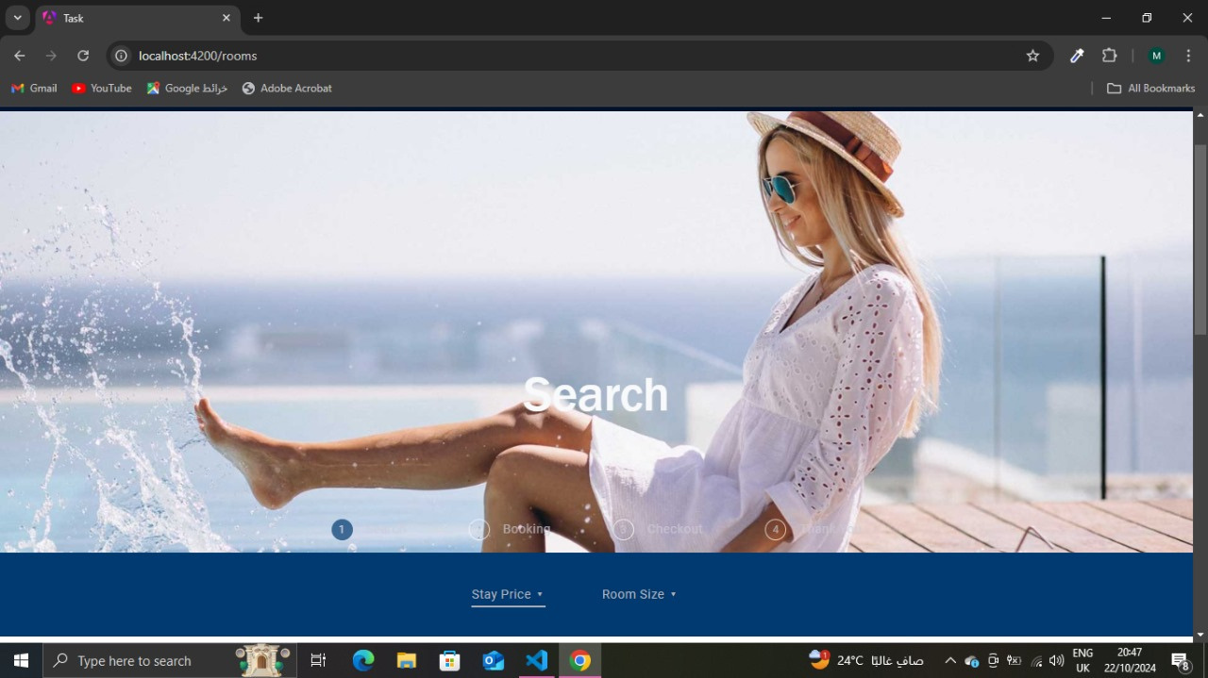
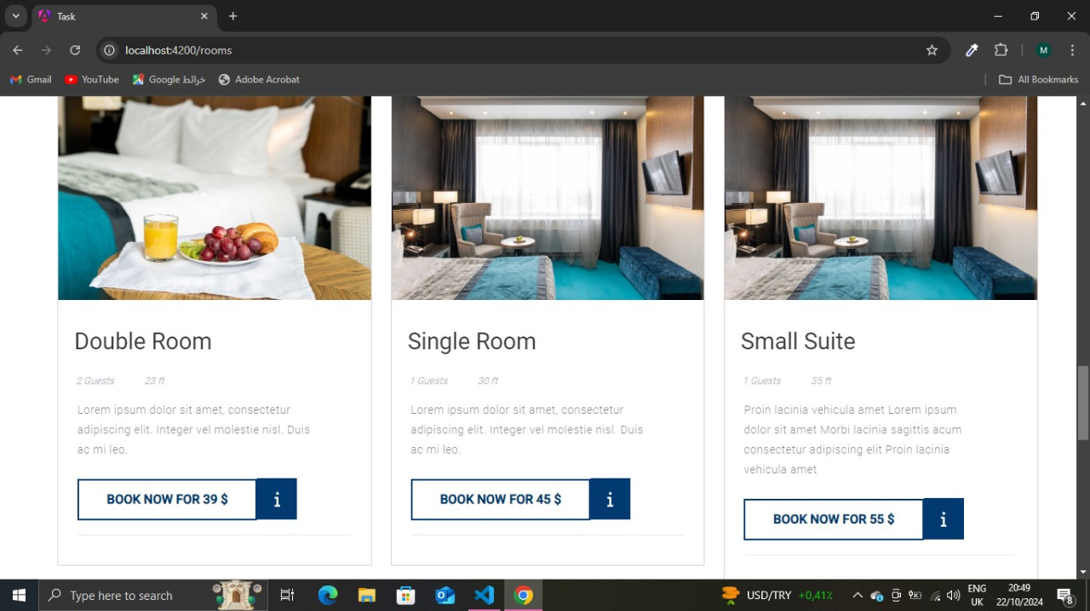
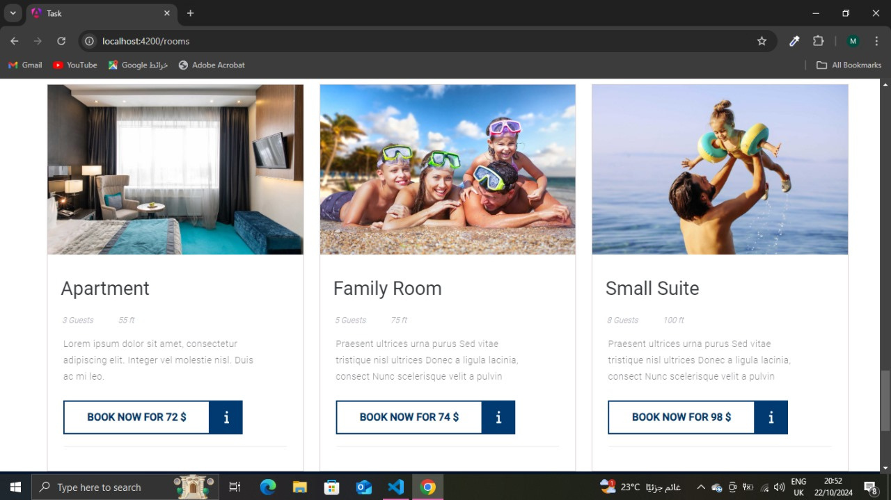
Rooms
15
16
17
18
19
20
21
22
23

Slide 18
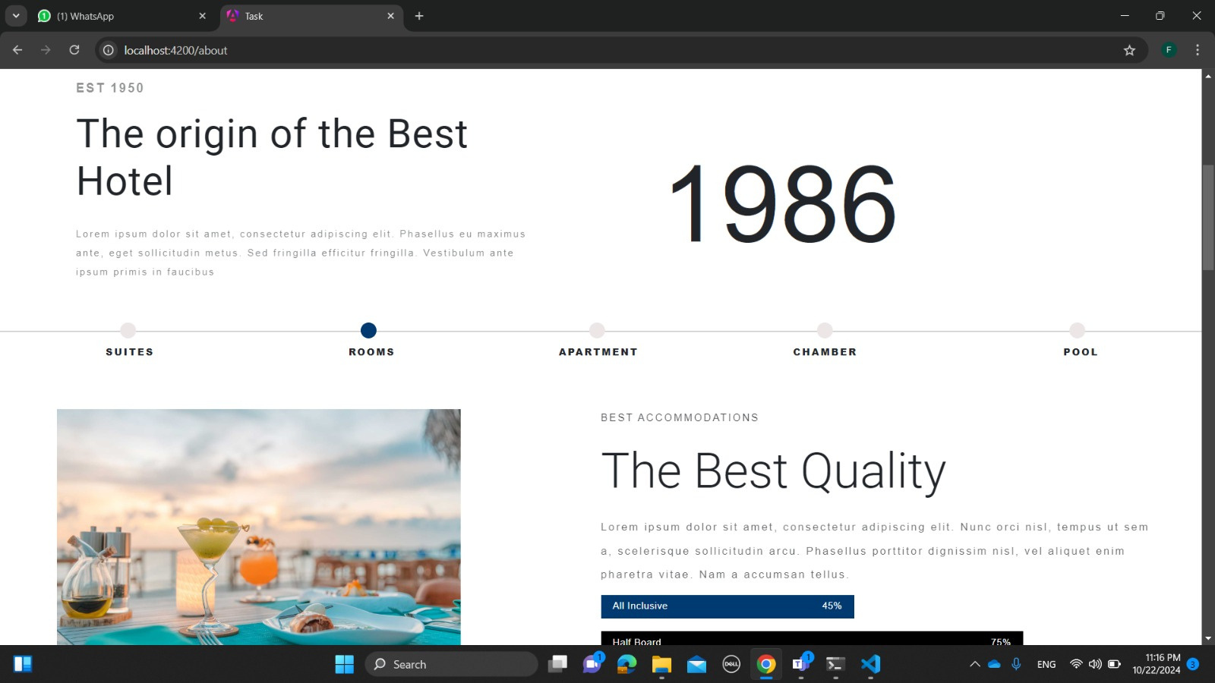
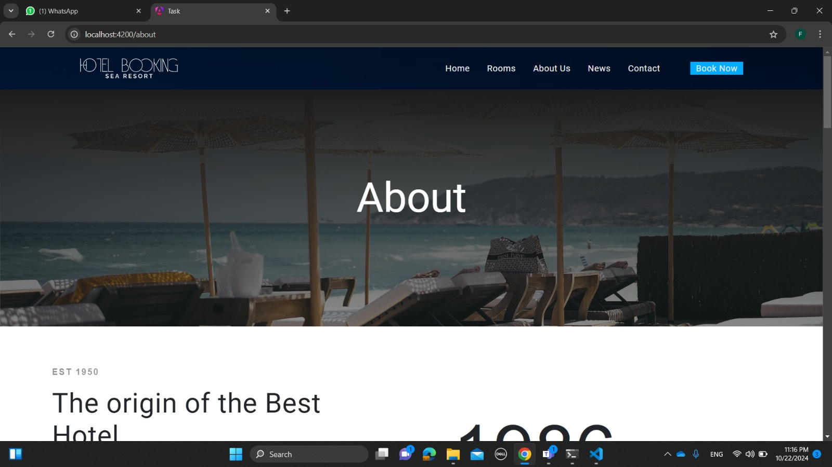
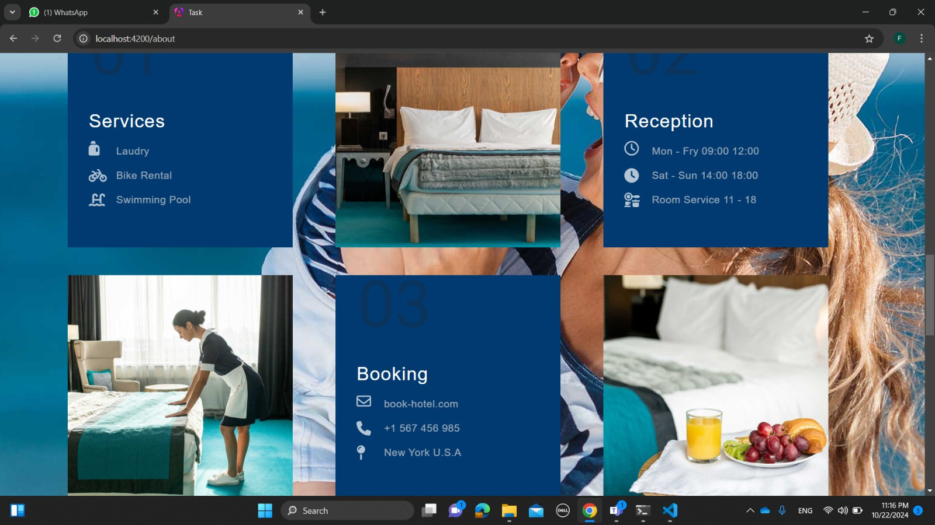
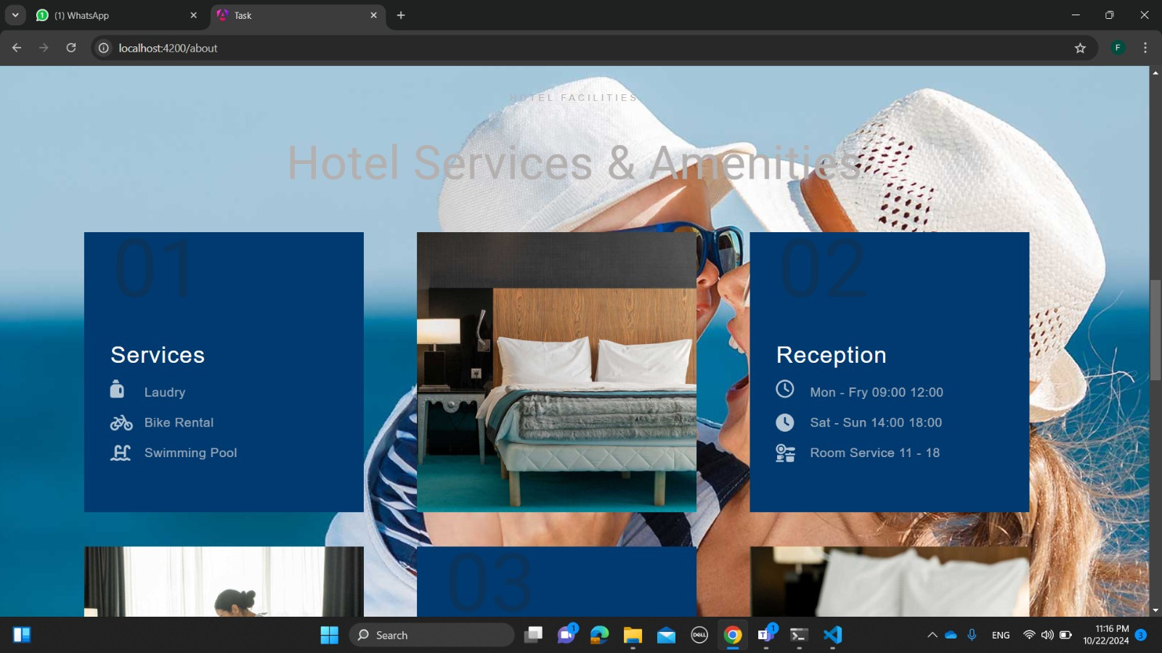
About Us
15
16
17
18
19
20
21
22

Slide 19

About Us
15
16
17
18
19
20
21
22

Slide 20

News
15
16
17
18
19
20
21
22

Slide 21


Contact
15
16
17
18
19
20
21
22

Slide 22



Booking
15
16
17
18
19
20
21
22

Slide 23


Checkout
15
16
17
18
19
20
21
22

Slide 24
THANK YOU

